Slide 1
AML 3303 Collaboration & Communication in AI/ML Software Teams

Slide 2
Why Collaboration Matters
AI/ML projects are team efforts, rarely solo.
Teams often span time zones, disciplines, and organizations.
Miscommunication = delays, bugs, failed deployments.
Good collaboration improves productivity, trust, and career growth.

Slide 3
Warm-Up: Tool Check
Show of hands. Which of these have you used?
Slack or Teams
Jira, Trello, or GitHub Issues
Notion, Confluence, or a team wiki
Then discuss (2 min): What made your last group project hard?

Slide 4
Project Management in AI
Software Engineering
• Managing AI projects requires handling unique
challenges such as data dependencies, model
training times, and iterative development cycles.
• Project Management methodologies like Agile,
Scrum and Kanban are often adapted to fit the
needs of AI projects, enabling teams to respond
quickly to changes and iterate effectively.
• Close collaboration between data scientists,
engineers and stakeholders is crucial for the
successful management of AI projects, ensuring
alignment across all aspects of development.

Slide 5
Who Is on an AI/ML Team?
Match the role to the task (3 min):
Data Scientist • ML Engineer • MLOps Engineer
Product Manager • Data Engineer • Domain Expert
Tasks: build the data pipeline; pick the metric; deploy and monitor the model; write the spec; label edge cases; tune the model.
Ask yourself: which role do you want in your first job?

Slide 6
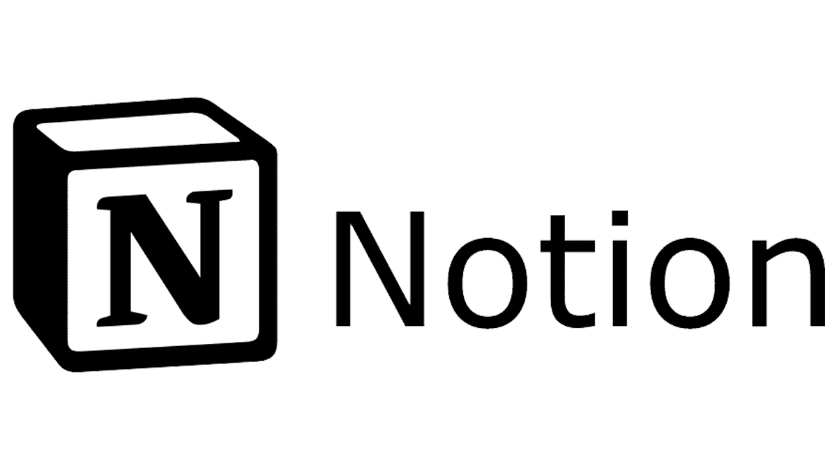



Tools vs Practices
Tools: Slack, Jira/Trello, GitHub, Notion.
Practices: Tech Specs, Daily Standups, Documentation culture.
Tools change → practices stay.

Slide 7

Tech Specs (Technical Specifications)
Purpose: Align the team before coding; define scope, design, risks, and success metrics.
Benefits:
Avoids miscommunication
Speeds up onboarding for new team members
Reduces rework and wasted effort
Example Sections in AI/ML Tech Specs:
Project overview
System design/architecture
Dataset & preprocessing plan
Model selection & evaluation metrics
Risks & mitigation strategies

Slide 8
Daily Standups
Purpose: Quick team sync (5–15 mins), usually at the start of the day.
Focus Areas (3 Questions):
What did I accomplish yesterday?
What will I work on today?
Any blockers?
Benefits:
Keeps everyone on the same page
Highlights blockers early
Promotes accountability in distributed teams

Slide 9
Activity: 3-Minute Standup
In groups of three, 5 minutes total.
Each person gets 60 seconds:
Yesterday → Today → Blockers
One person times it. No problem-solving in the standup.
Debrief: what was hard to keep short?

Slide 10

Documentation Culture
Purpose: Preserve knowledge, ensure reproducibility, and facilitate collaboration.
Best Practices:
  Document decisions, assumptions, and workflows
  Maintain README files, wikis, and experiment logs
  Update documentation as the project evolves
Benefits:
  Smooth handover between interns, new hires, or team members
  Reduces errors from forgotten steps
  Makes debugging and model maintenance easier

Slide 11

Messaging Tools in Industry
Slack → most popular in startups, research labs.
Microsoft Teams → enterprises, corporates.
Discord → dev communities.
What matters:
Channels for projects
Threads for focus
Integrations (GitHub, CI/CD, bots)

Slide 12
Project Management Tools
Trello – Kanban boards (To Do → Doing → Done).
Notion – docs + tasks + wiki.
Jira – industry-standard for Agile workflows.

Slide 13
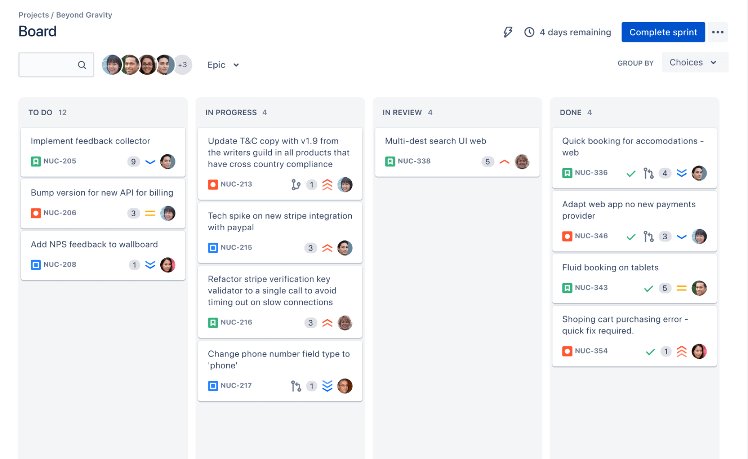

Slide 14
Beyond Tools: Industry Practices
Tech Specs before coding → clarity first.
Daily async updates → Slack standups.
Documentation-first culture → avoid knowledge loss.
Automation → bots for testing, alerts, reminders.

Slide 15
AI Assistants for Teamwork
Where AI helps: turning rough notes into a tech spec, summarizing long threads, drafting pull request descriptions and release notes.
Try it now (5 min): paste your standup notes into Claude or Copilot and ask for a three-bullet status update for your team channel.
Check the output: is it accurate, short, and safe to share?
Rule: never paste confidential data or credentials.

Slide 16
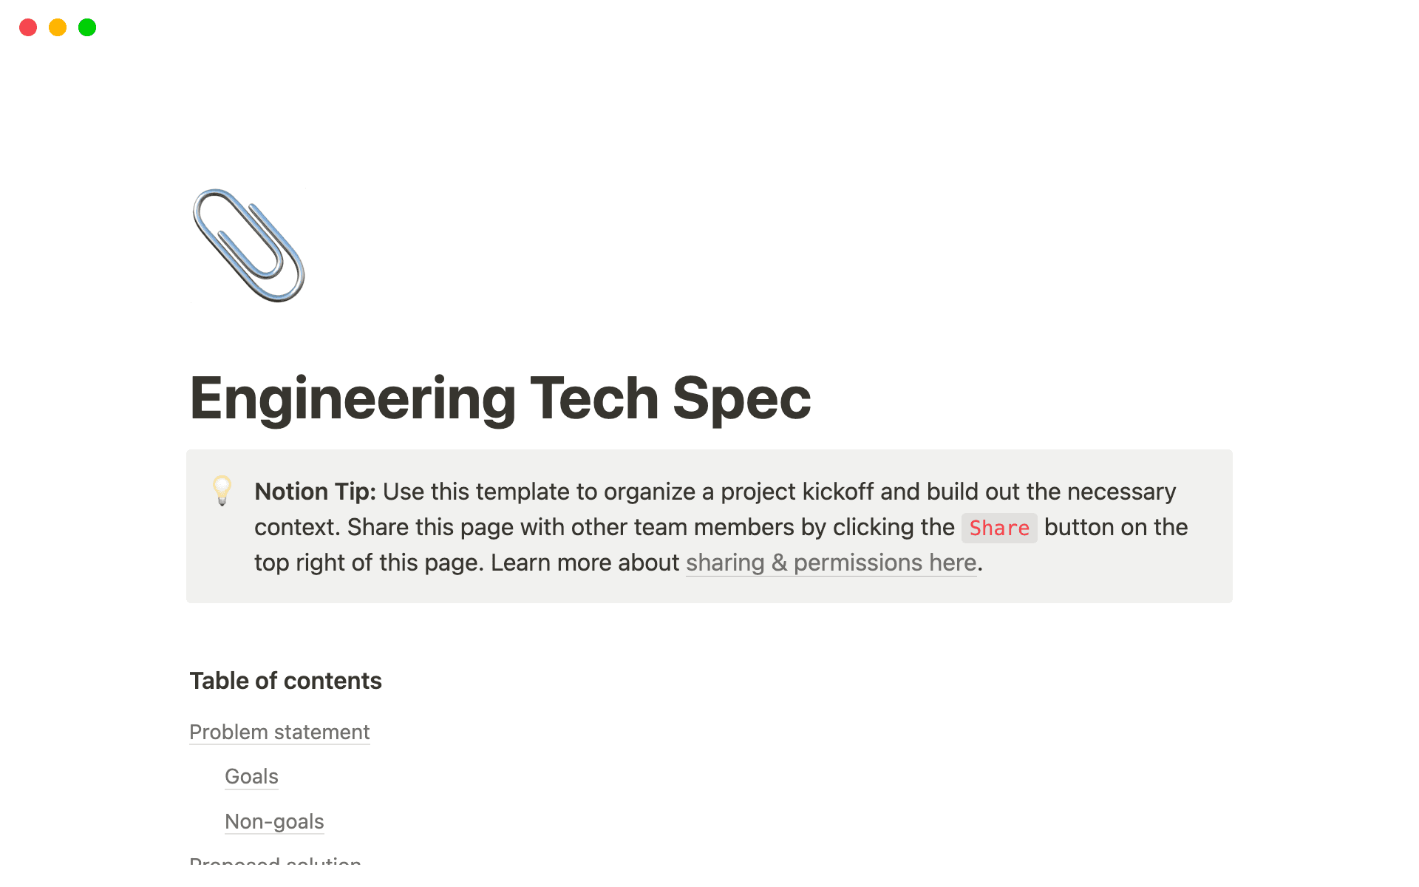
Hands-On (Notion Tech Spec)
Mini Individual Task (20 mins):
Create a one-page tech spec in Notion.
Include:
Title & Author
Overview (2–3 sentences)
Scope (in-scope, out-of-scope)
Plan (3 steps: data → model → eval)
System design / architecture
Success metric

Slide 17
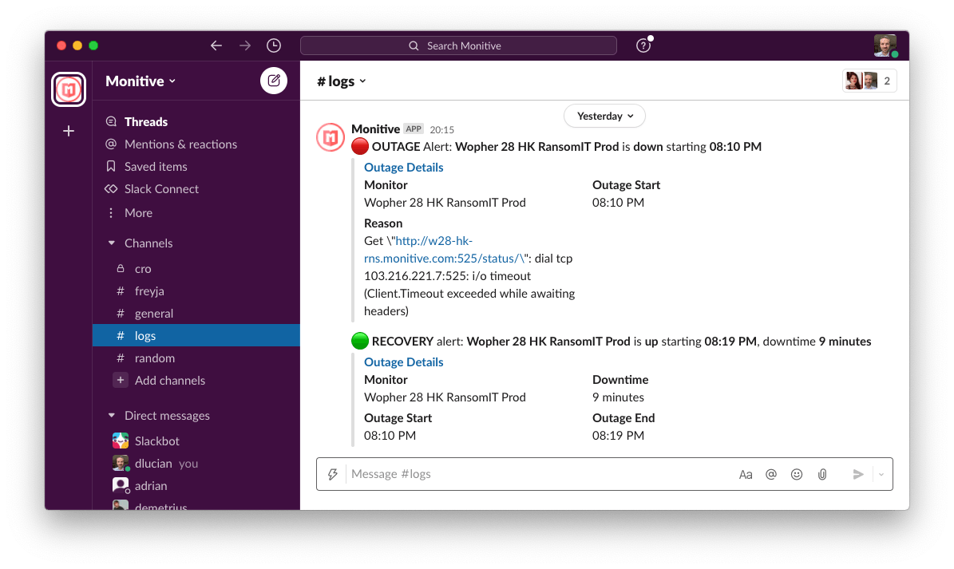
Hands-On (Slack Automation)
Task: Connect Python with Slack Webhook → send training updates.
Example: Notify when model reaches target accuracy.
Real-world use: Alerts in ML pipelines.

Slide 18
Key Takeaways
Collaboration = core industry skill.
Tools are temporary, principles last.
Slack, Trello, Notion → just starting points.
Build habits of communication, documentation, automation.

